Slide 1
XSLT
Service-Oriented Software Engineering
Software Institute
Nanjing University
Bei Jia

Slide 2
XSL Transformations (XSLT) Overview

Slide 3
The XSLT Process

Slide 4
Anatomy of a Stylesheet

Slide 5
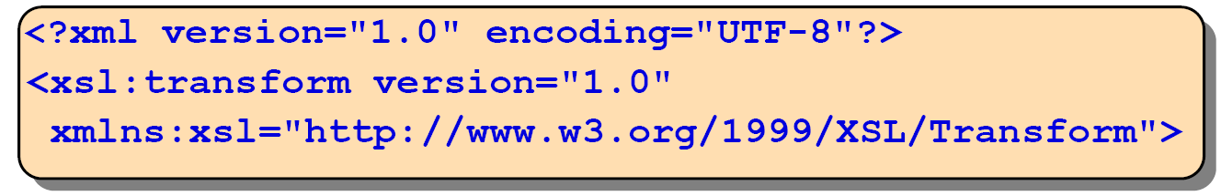
<xsl:stylesheet Element
xsl:stylesheet is the root element of an XML stylesheet.
Requires the XSL namespace.
Current recommendation:
Alternatively (not supported in all XSL processors):

Slide 6

XSL Optional Elements
Stylesheets may:
  Import/include other stylesheets
  Set global variables, constants, or matching patterns
  Determine how to treat white space
  And so forth
These elements appear before the first xsl:template
  Allows inclusion of an external XSL stylesheet
  Supplements calling stylesheet
  Control output format

Slide 7
<xsl:template Element
A stylesheet has one or more templates.
  When <xsl:template> is missing, and literal result elements are found, a match="/" template is assumed (match the root)
Specifies:
  A match expression that defines when this rule will be used (the test against the nodes in the XML tree) - this is an XPath expression
  Literal result text is written to the output tree, XSLT elements are executed

Slide 8
Pattern Matching (XPath) Examples
Matching all children of book.
Using an OR statement.
  OR matches have the lowest priority
Testing (using predicates) for a condition.
  Any XPath predicate test may be used
Any test can use the not() function.

Slide 9
Control Elements
<xsl:apply-templates/>
<xsl:call-template name= "templateName"/>
  Calls a template named "templateName"
<xsl:if>
  Allows a conditional test or tests.
<xsl:choose>
  Allows a choice of one or more tests and permits a default condition:
    <xsl:when> the tested condition
    <xsl:otherwise> the default condition
<xsl:for-each>
  Used to iterate over the result of an XPath expression

Slide 10
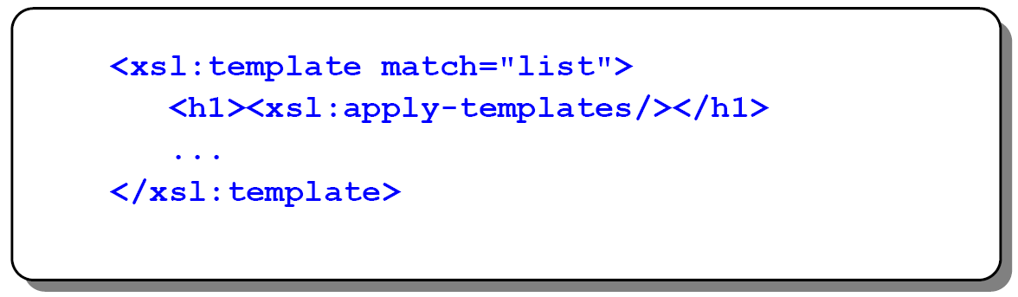
<xsl:apply-templates Element
Means select all of the children of the current node in the XML source tree. For each one, find the matching template rule in the stylesheet and process that rule.
Rules that can be matched are:
  None - you are not required to have a template rule for each child node
  The template match rules you define
  Default rules built in to the XSL processor
Applies rules recursively

Slide 11
<xsl:call-template Element
Templates can be named and invoked by name
  All templates must have a name or a match attribute
When calling a template, the current node remains unchanged
Defining a named template
Calling a named template

Slide 12
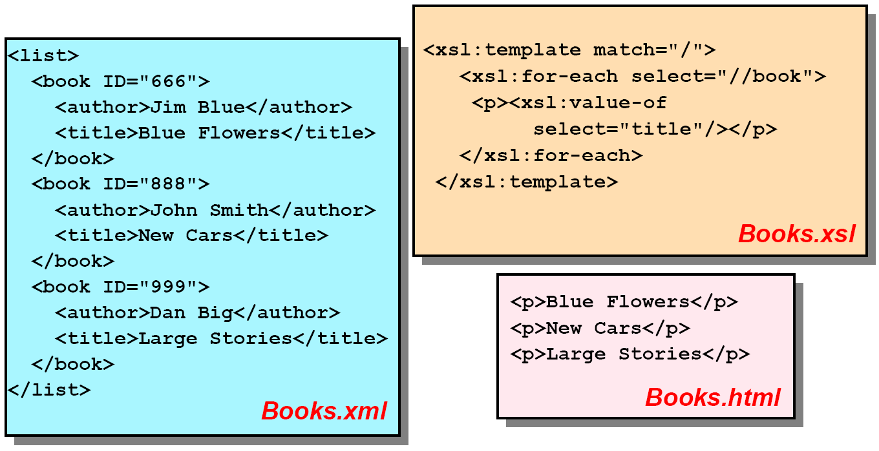
<xsl:for-each Element
Used to iterate over the result of the select expression
Selected node becomes the current node

Slide 13
<xsl:if Element
Used to conditionally process the matched expression
Can also be used with the logical not statement

Slide 14
<xsl:choose Element
Multiple when tests can be implemented.
The otherwise element is optional and must be the last child element of <xsl:choose> when present (used as a default if the other tests fail)

Slide 15
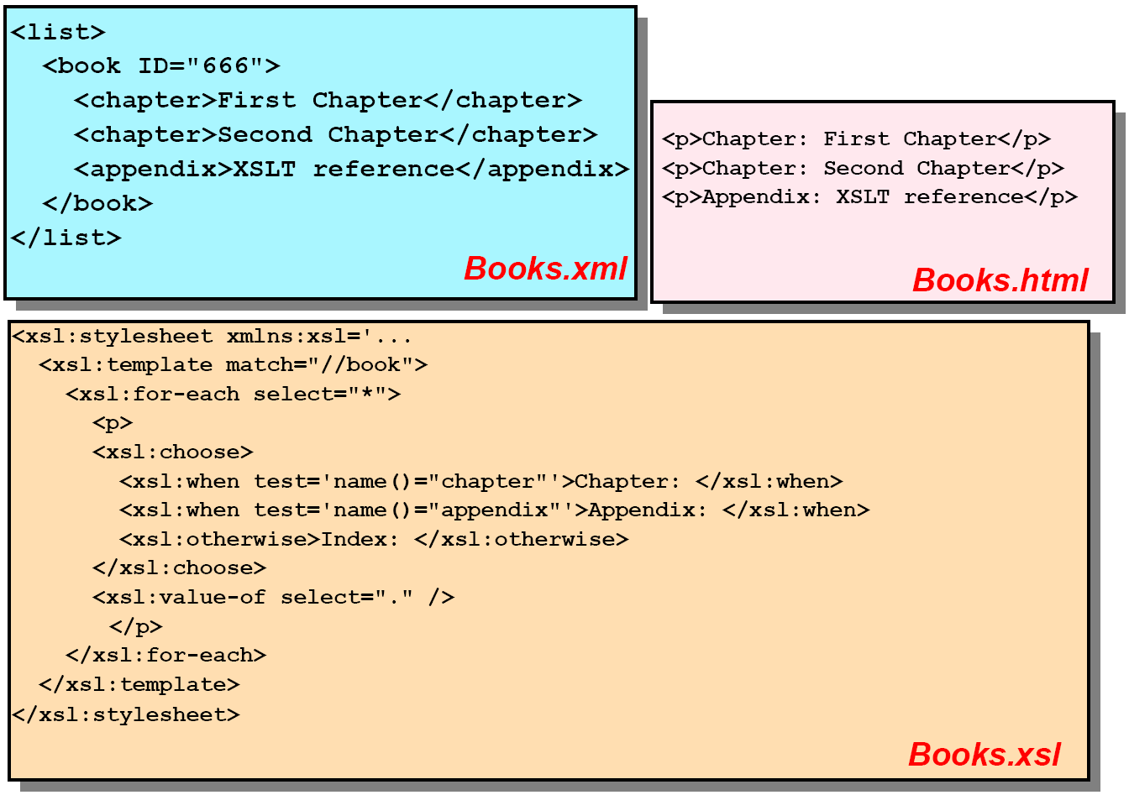
<xsl:choose Element

Slide 16
Elements to Generate Output
<xsl:value-of select="validXPathExprOrFunction">
<xsl:procssing-instruction name="piName"/>
  Inserts a processing instruction into the result tree
<xsl:apply-templates/>
<xsl:comment>
  Inserts a comment into the result tree
<xsl:text>
  Inserts text into result tree verbatim
  Used when outputting special characters, particularly whitespace

Slide 17
<xsl:value-of Element
Used to extract a specific value from the source tree
Inserts into result tree the verbatim contents of a string, an element or attribute from patternToMatch

Slide 18
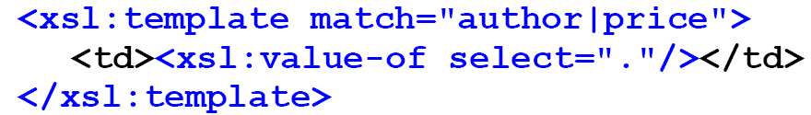
Default of <xsl:apply-templates/>
Can be used to output the value of the node being matched when used with leaf nodes
This example creates HTML table cells containing book authors' names and book prices:
Can be rewritten with the same result, using apply-templates:

Slide 19
Elements to Generate XML Output
Any and all XSLT elements can be used to transform from XML-to-HMTL or from XML-to-XML
But they are unwieldy and error prone
So, some elements are used for XML-Generation
  <xsl:element>
  <xsl:attribute>
  <xsl:copy>
    Copies the current nodes from source tree to result tree

Slide 20
<xsl:element Element
Creates an element in the result tree.
Content (inside xsl:element) can be:
  <xsl:attribute> (create attribute)
  <xsl:element> (create child element)
  Text
Alternative: <element-name> literal result elements

Slide 21
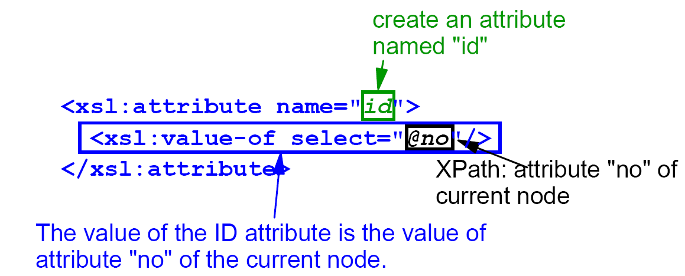
<xsl:attribute Element
Creates an attribute in the result tree
Content is the text value for the attribute
All attributes must precede first child element
  <xsl:attribute name="attribute-name">
  <!-- content: text value -->
  </xsl:attribute>
Example:

Slide 22
XML Input As a Tree

Slide 23
Desired HTML Output

Slide 24
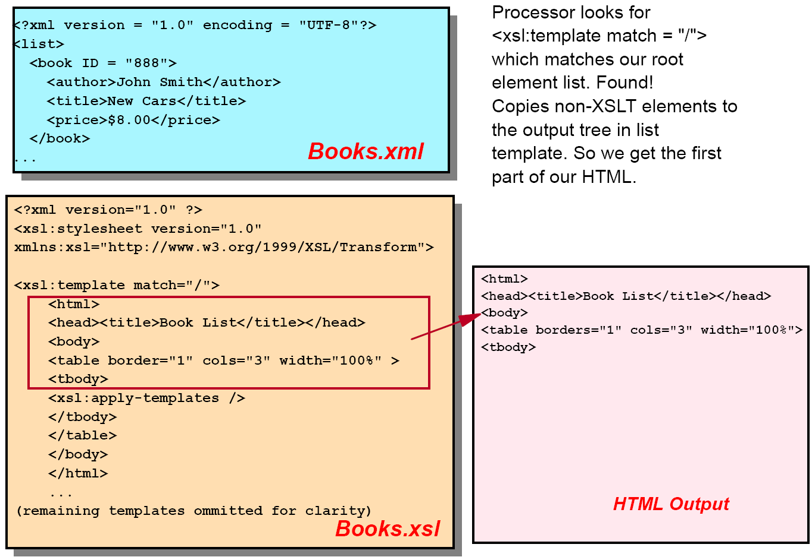
XML to HTML (1/5)

Slide 25
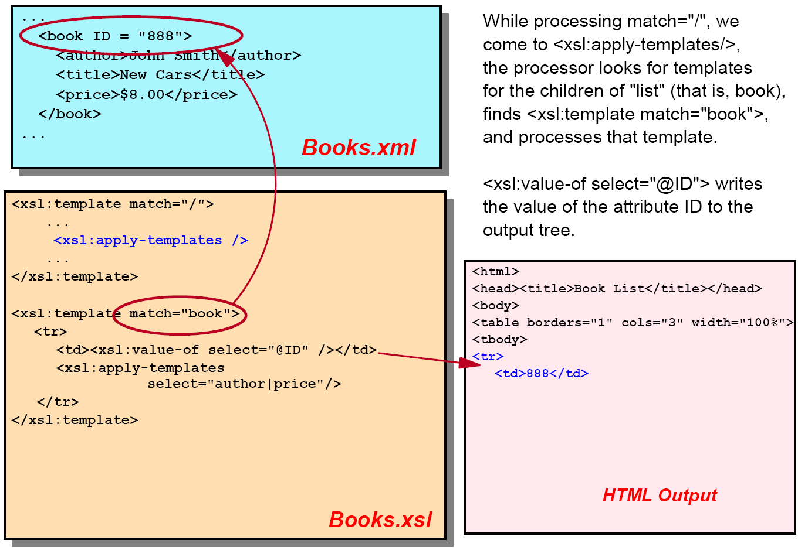
XML to HTML (2/5)

Slide 26
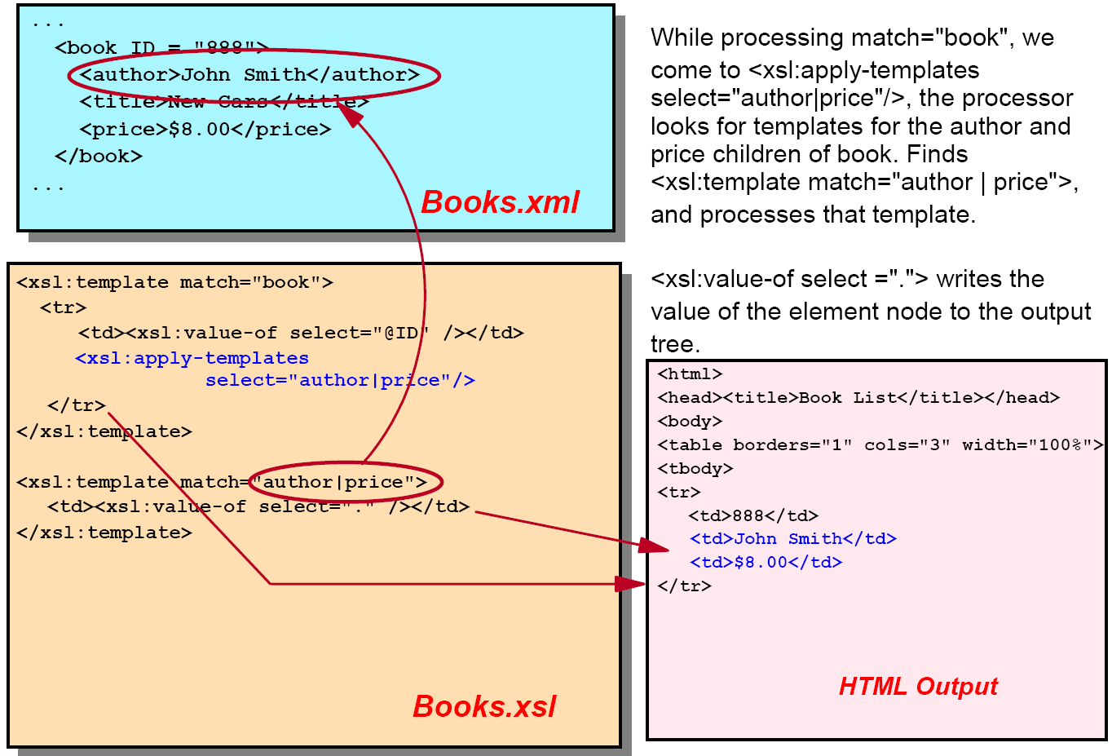
XML to HTML (3/5)

Slide 27
XML to HTML (4/5)

Slide 28
XML to HTML (5/5)

Slide 29
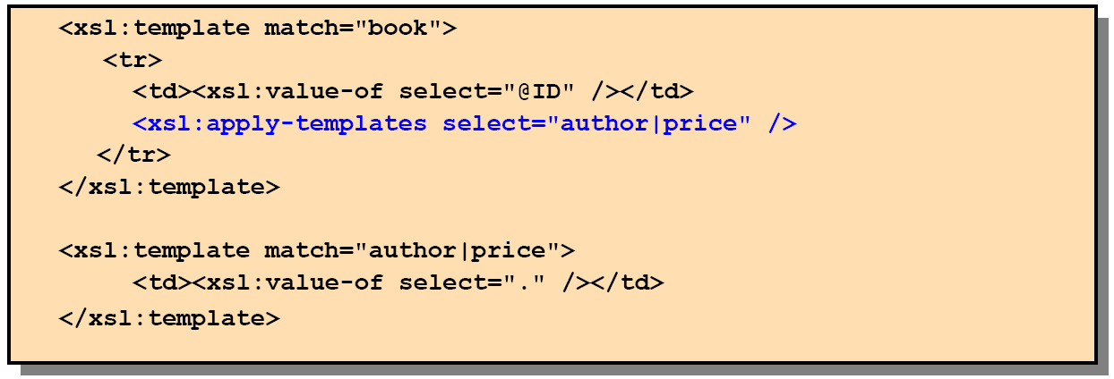
Calling <xsl:apply-templates/>
For greater control over which nodes are processed, explicitly call the templates for specific nodes
You are not looking for a specific template, but for the template for the specific node
In our prior example, we decided that only the price and author of the book should be output not the title

Slide 30
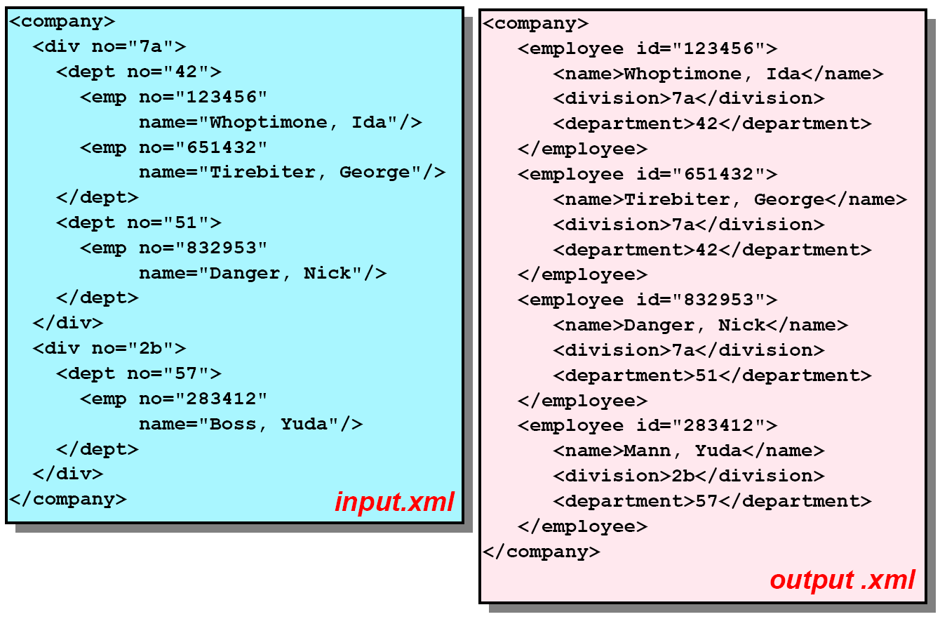
XML to XML Example (1/2)

Slide 31
XML to XML Example (2/2)

Slide 32
Numbers, Sorting, and Functions
<xsl:number>
  Used to allocate a sequential number to the current node
  Used to format a number
<xsl:sort>
  Means to sort a collection of nodes in ascending or descending order
Functions
  Built into XPath and/or XSLT
  Used in the XPath expressions

Slide 33
Working with Numbering in XSLT
Emit number sequences with:
<xsl:number level="lvl" value="nbrExp"
count="node" format="nbrFmt"/>
  Emits numbers only, item content is emitted separately
  The level attribute determines depth
  The value attribute determines the numbering value
  The count attribute determines which elements are counted
  The format attribute determines how the numbers are formatted
Number operations are applied to the result tree for the current node
If numbering is applied after a sort, use value="position()", otherwise the items may appear out of sequence

Slide 34
<xsl:number Element format Attribute Values

Slide 35
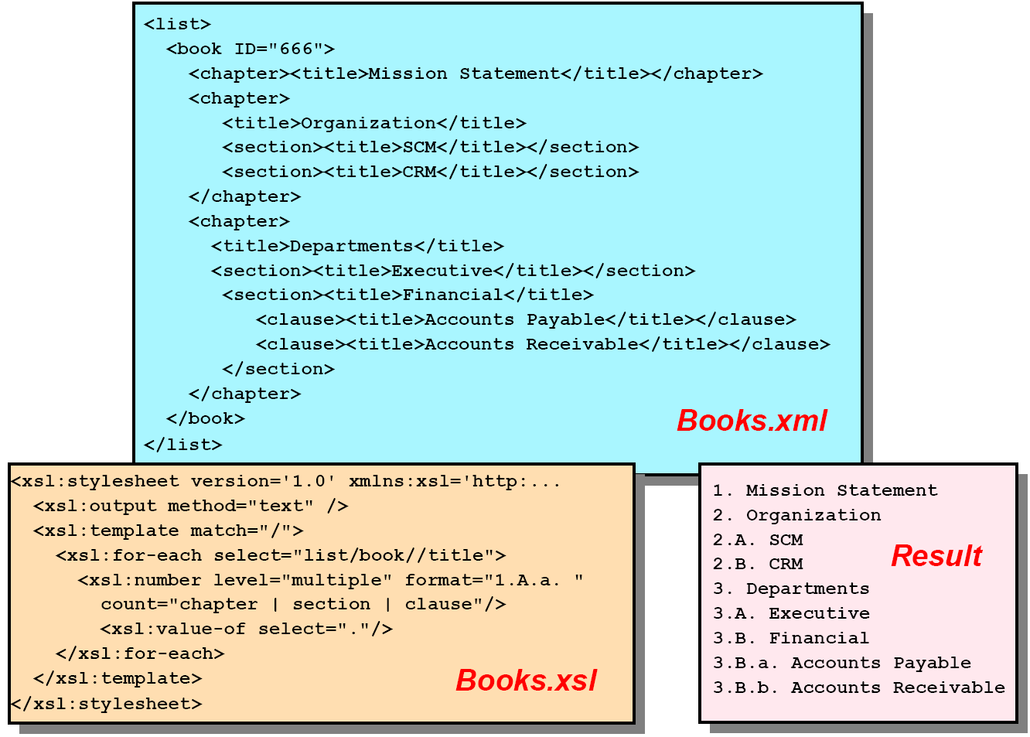
<xsl:number Example

Slide 36
<xsl:sort Element
A means to sort a collection of nodes in ascending or descending order
Provides alphabetic or numeric sorting.
Used within <xsl:apply-templates> or <xsl:for-each>
Sort before numbering!

Slide 37
<xsl:sort Attributes
order (establishes the sorting order)
  Value: ascending | descending
lang (language encoding, per xml:lang)
  Default: EN-us (is of type nmtoken)
data-type (assigns data types to node strings)
  Value: text | number | QName
case-order (sets precedence for upper or lower case)
  Value: upper-first | lower-first
  Default: lower-first (for US English)

Slide 38
Sort Example

Slide 39
XPath/XSLT Functions

Slide 40
Other Elements
Attribute value templates
Variable
Parameter
Not Covered
Key
<xsl:apply-imports>
  Applies imported stylesheet templates against the current node and its children

Slide 41
Attribute Value Templates
Uses the curly brace characters "{" and "}"
Match attribute values in result-tree elements
Evaluated while processing
Replaced immediately

Slide 42
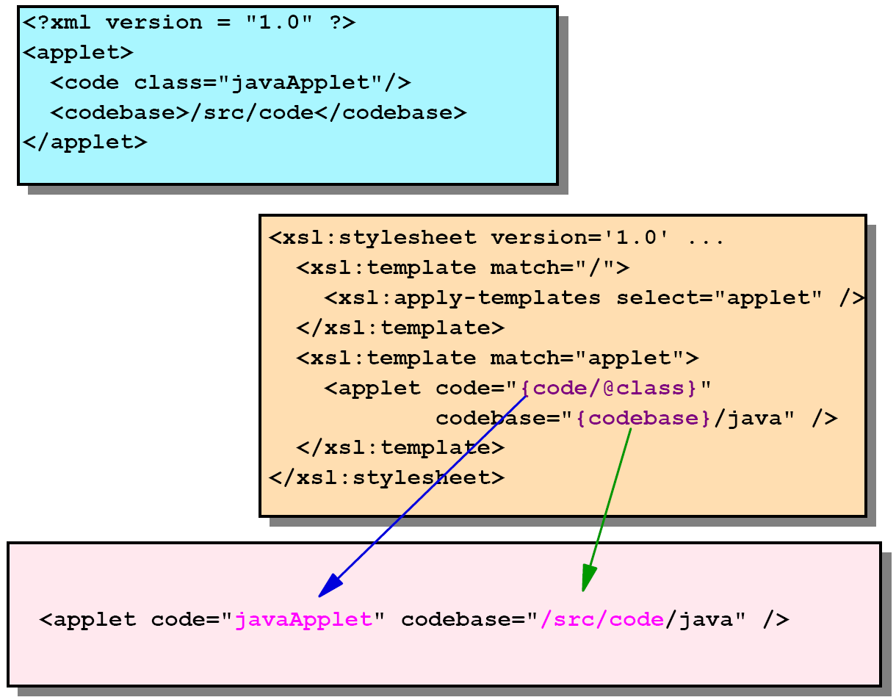
Attribute Value Templates Example

Slide 43
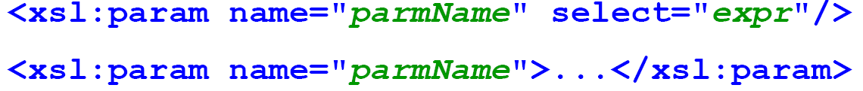
Variables and Parameters
Variables
  Use $varName to retrieve content
Parameters
  Mainly used to call named templates.

Slide 44
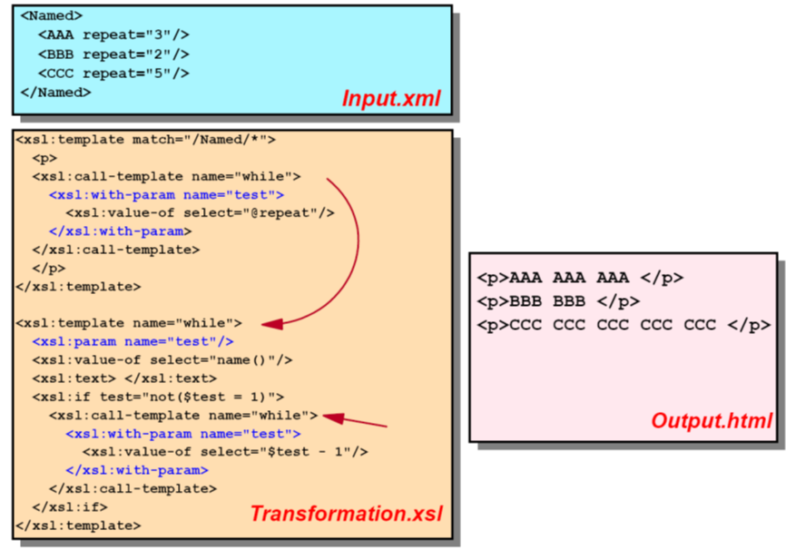
Parameters Example

Slide 45
Variable Example

Slide 46
No Reassigning Variables
Variables cannot be reassigned
  We want pure, side-effect free functions which are not dependent upon order of execution
Conditional Initialization
  Want to assign a variable based on a condition
Often variables are used for doing two tasks at once
  Divide the templates into two templates
  Example, calculate min and max of a list of nodes
No counters or counted for-loops
  Write recursive template instead

Slide 47
Common Named Template Example (1/2)
You have an order page which is editable at times and read-only at other times. Add a readOnly attribute to your "page" XML tag
  Option1: write 2 separate XSLT files
  Option2: have common templates which have choose logic which evaluates the readOnly attribute and determines the appropriate output

Slide 48
Common Named Template Example (2/2)

